Slide 1

Instagram For Business
Risk Management
The Bomb Squad : Venkat Sabbineni, Ipsa Ojha, Jeremiah Warren, Kaustuv Dutta, Swati M. Radia

Slide 2
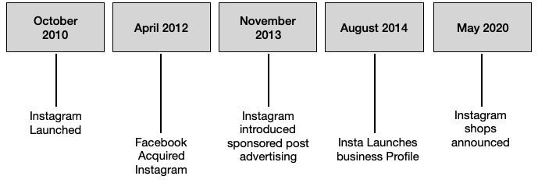
Instagram Timeline

Slide 3
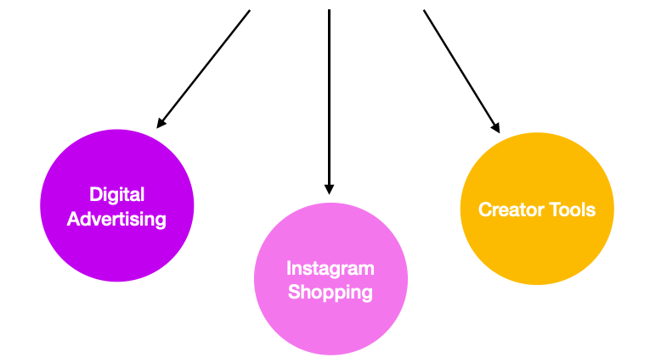
Instagram Business Model
Instagram Business Model

Slide 4
Instagram - Attacks
Data Leak in January 2021 Discloses Scraped Information on 214 Million Social Media Accounts
49 million records were exposed in the Chtrbox database in May 2019.
March 2019: Unencrypted Storage of Hundreds of Millions of Passwords.
Contact information for 6 million account holders was compromised in August 2017.
InstaAgent App Caught Stealing Passwords in November 2015.

Slide 5
Instagram For Business
Instagram for Business was launched in the year 2014 after the sponsored posts gained a huge popularity.
Normal user profile can be converted it to business account
Upload posts, videos, reels and advertisement posts(paid).
Two ways to shop from business accounts.
Link company website in bio.
Set up Instagram shop.

Slide 6
Instagram Shop
Set up Instagram shop for the business account.
Create Facebook business manager account and link the Instagram business page.
Choose one of the payment checkout method.
Using another website.
Using Facebook or Instagram – meta pay.
Using messaging.
Create a catalogue of products
Post product pictures with product tags that have price information.
Customers can click on the tagged links and directly start shopping.

Slide 7
Our Scenario
Painted is a clothing boutique selling customized clothing
The company was founded by two friends in 2018, and it became popular when Painted’s designs went viral on Instagram during the pandemic
In 2020, the company decided to shift its business model to focus on sales through Instagram’s Instagram for Business platform, and now 60 percent of the company’s sales come from the company’s Instagram shop
Has five full-time employees, a company-owned warehouse, IT infrastructure, and company laptops for each employee
Experienced four different threats last year, and the company is considering controls to address each threat

Slide 8
Risk Assessment
Assets
IT Infrastructure (Servers, Company Website)
Customer PII
Instagram Profile
Reputation
Company Staff
Warehouse
Company Laptops (Hardware)
Threats
DOS
Account Hacking
Phishing Attacks
Insider Threat
Vulnerabilities
Patching issues
Weak Credentials
No MFAs
Relying on non-efficient third party
Undertrained customers or employees
Controls
Firewall
Multi Factor Authentication (MFA)
Security trainings for staff
RBAC

Slide 9
Weighted Factor Analysis - Assets
We chose to evaluate our assets using the following criteria: Impact on Revenue (35%), Most Critical for Success (30%), and Impact on Public Image (35%)
Since Painted is a small business, we decided that impact on revenue needed to be one of the most important criterion in our analysis
Painted is reliant on social media, and its public image is also very important, so we allocated 35% for this criterion as well
We thought most critical for success was slightly less important
Top 2 Results: Reputation of the company and Painted’s business Instagram profile

Slide 10
Weighted Factor Analysis - Threats
We chose Probability of Success (35%), Cost to Protect (30%), and Financial Loss if Successful (35%)
Since all the threats are costly to Painted’s bottom line, we chose Probability of Success and Financial Loss if Successful as our two most important criteria
We allocated slightly less importance to Cost to Protect, because the controls cost less than the attacks themselves
Top 2: Accounts being hacked and phishing attacks

Slide 11
Threat Vulnerability Assessment
Using weak passwords.
Not turning ON Multi factor authentication.
Using stronger Firewall, IDS and IPS systems.
Lack of security training policy of employees.
Not implementing RBAC
Physical security for office spaces and warehouse.

Slide 12

Risk Calculation
Impact value is the cost incurred by each threat.
Likelihood - Number of times an attack occurred divided by total number of attacks happened in a year.
Percentage Mitigation - Present Controls.
Assumed percentage uncertainty as 10%.
Risk = (Likelihood X Impact) - % Mitigation + % Uncertainty
Account Hacking has the highest value for risk.
Account Hacking

Slide 13
Cost Benefit Analysis (CBA)
CBA = ALE (pre-control) - ALE (post-control) - ACS
Calculated CBA for controls for account hacking which is Multi Factor Authentication (MFA).
2 Controls - Issuing iPad to each employee or Issuing an RSA token to each employee.
Based on calculations, Painted should go with first control i.e., issuing iPad.

Slide 14

Questions ??

